Slide 1
2018-1-PL01-KA229-050699 SCIENCE OLYMPICS

Slide 2
PYRAMIDS

Slide 3
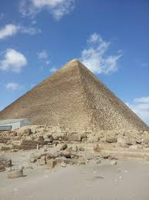
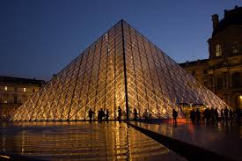
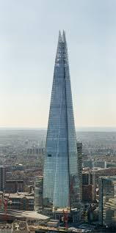
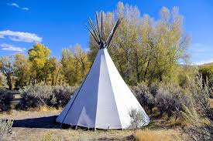
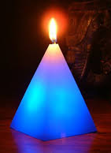
Examples of pyramids

Slide 4
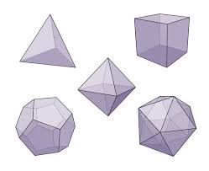
Pyramids
(like prisms)
are
polyhedrons.

Slide 5
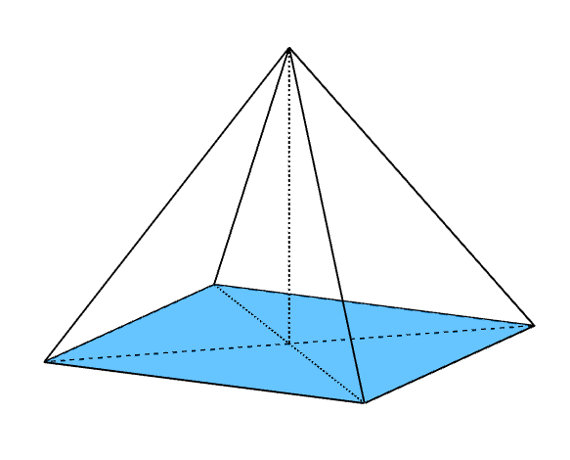
Any polygon can be
the base
of a pyramid.

Slide 6
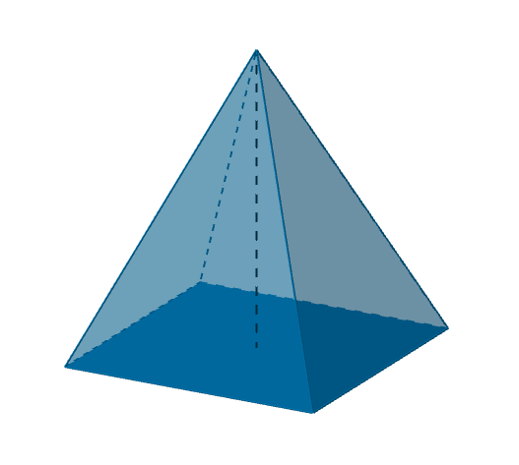
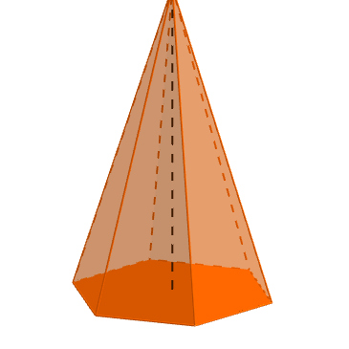
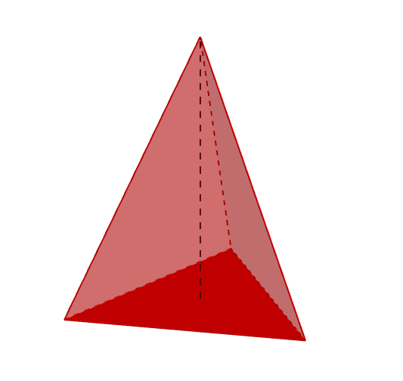
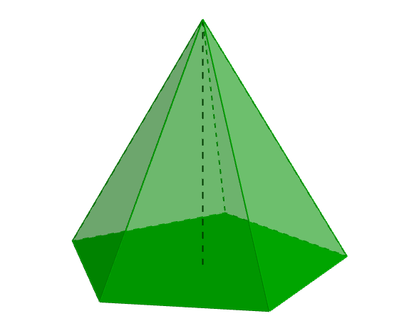
Depending on what polygon there is in the base, the pyramids can be triangular, square, pentagonal, etc.
https://www.geogebra.org/m/qbcrcery

Slide 7
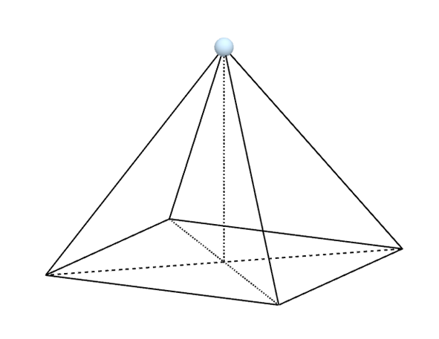
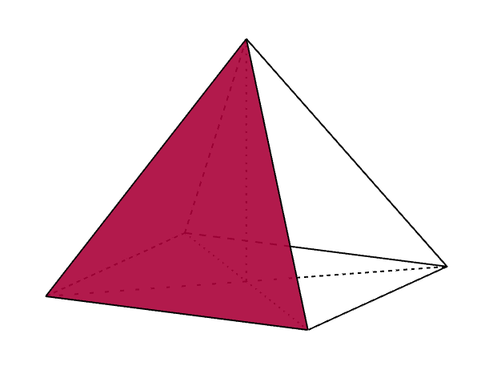
appex
Each base edge and apex form a triangle, called
a lateral face.
lateral face

Slide 8
A pyramid with n sided polygon as its base has:
$$n$$ | lateral faces
$$n+1$$ | sides
$$n+1$$ | vertices
$$2n$$ | edges

Slide 9
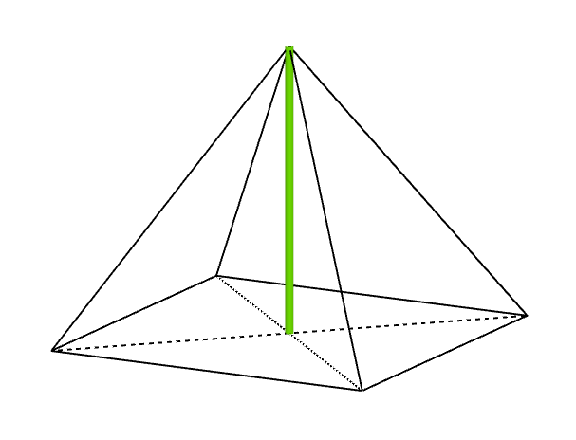
The distance from the appex to the base (or the plain containig the base) is called
the altitude of the pyramid.

Slide 10
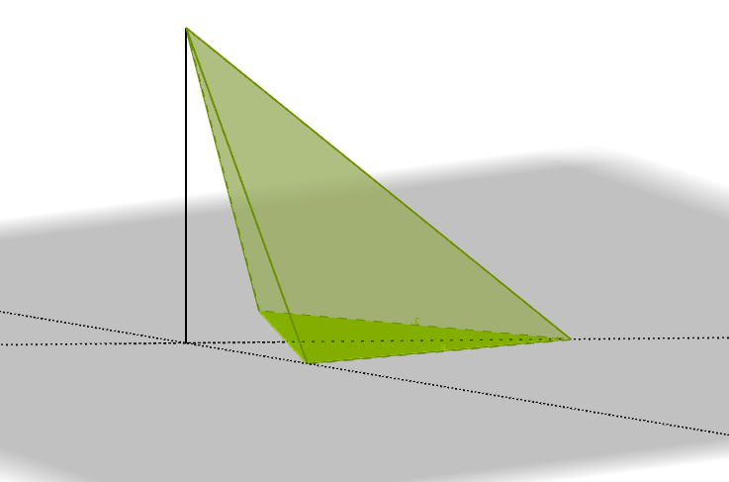
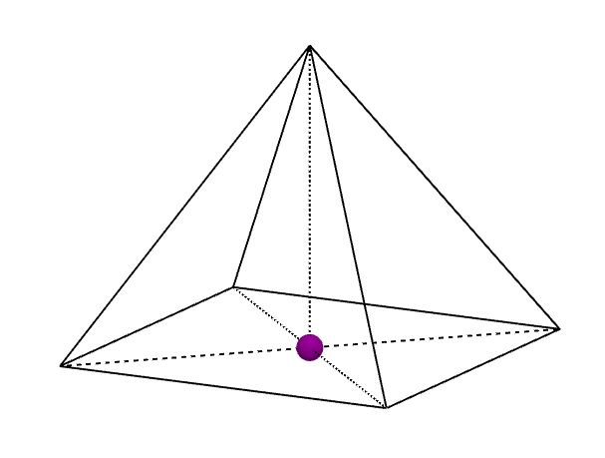
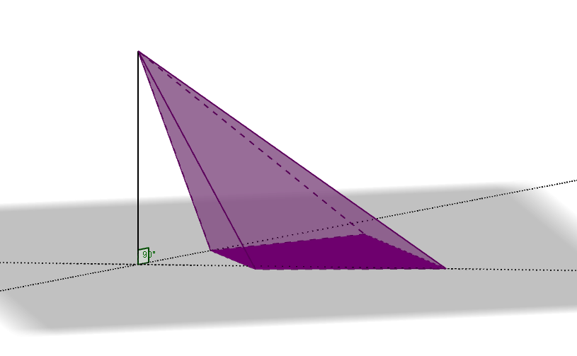
If a pyramid has its apex directly above the centroid of its base it is called
a right pyramid.
Nonright pyramids are called
oblique pyramids.
https://www.geogebra.org/m/pj9vdvfd

Slide 11
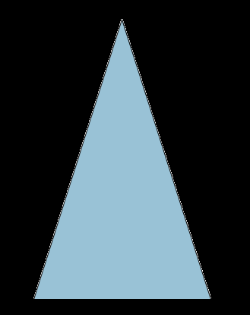
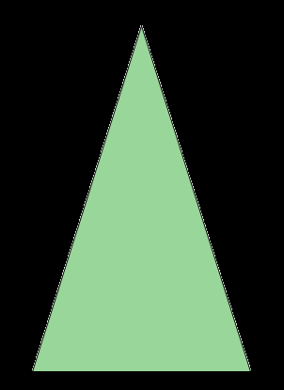
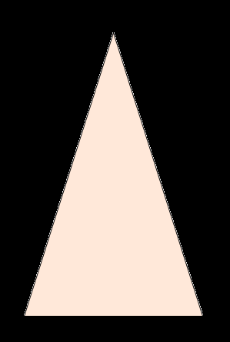
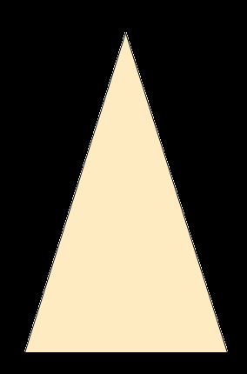
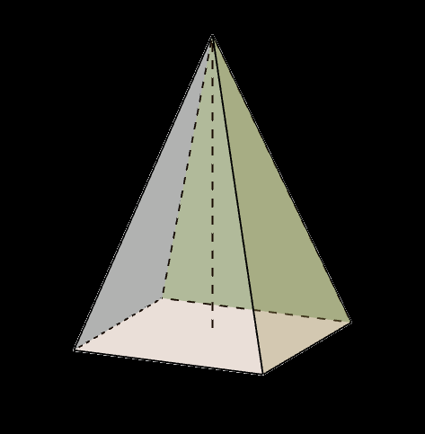
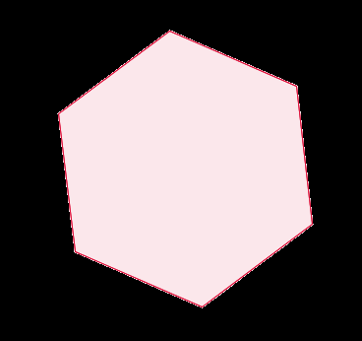
A regular pyramid has a regular polygon base and is usually implied to be a right pyramid.
What can be a base of such a pyramid?
What can we say about its faces?

Slide 12
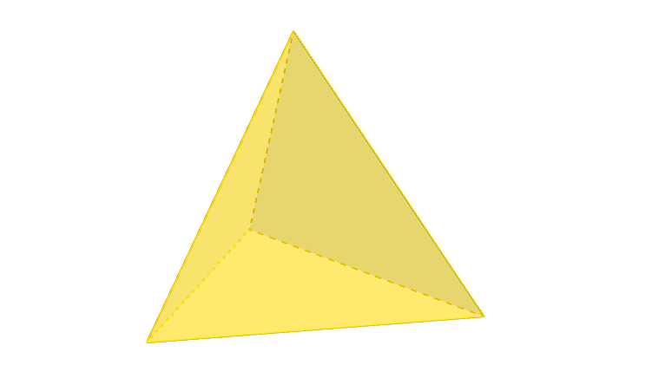
A triangular pyramid (also called a tetrahedron) has four triangular faces, six straight edges, and four vertex corners.
A regular tetrahedron is one in which all four faces are equilateral triangles.
https://www.geogebra.org/m/qbcrcery

Slide 13
Parts of a pyramid
GeoGebra Applet https://www.geogebra.org/m/kgbtprdf
Kahoot Quiz https://create.kahoot.it/share/parts-of-a-pyramid/6e81429a-4700-4755-9c80-98d248c3b258

Slide 14
„Pyramids – faces, vertices and edges” https://create.kahoot.it/share/pyramids-faces-vertices-and-edges/fd544eab-0dcd-4771-be47-dc379aa0d714

Slide 15
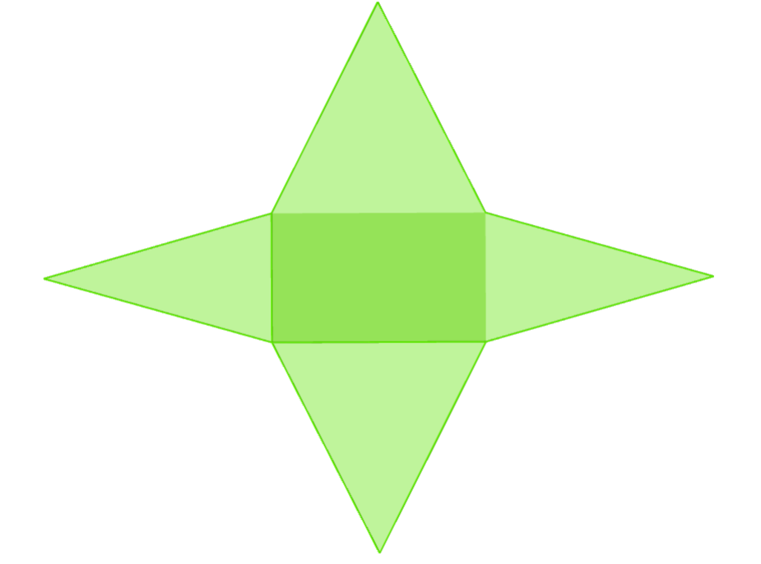
Pyramid net
GeoGebra Applet „Nets of various pyramids” https://www.geogebra.org/m/a3m7mpna

Slide 16
How to fold a rectangular sheet of paper to obtain a regular tetrahedron net?
A regular tetrahedron net

Slide 17
Cross-sections of pyramids
https://www.geogebra.org/m/dkqvwc4m
https://www.geogebra.org/m/tmvqtaez

Slide 18
Surface area of a pyramid
the sum of the areas of its sides
surface area of its net
base area + lateral area

Slide 19
Homework
Pair up.
One person of each pair is going to make a model of a prism, the other – a model of a pyramid.
The solids should have the same bases and altitudes (decide with your partner which polygon you want to have as a base and how big you want your solids to be).
Make your models of a thick paper/cardboard and bring them to the next class.

Slide 20
Volume of a pyramid
The experiment
https://www.youtube.com/watch?v=-rxwXQKrjAU

Slide 21
Volume of a pyramid
How do we count the volume of a prism?
→ $base area∙prism altitude$
How do we count the volume of a prism?
→ 𝑏𝑎𝑠𝑒 𝑎𝑟𝑒𝑎∙𝑝𝑟𝑖𝑠𝑚 𝑎𝑙𝑡𝑖𝑡𝑢𝑑𝑒
What can you say about a pyramid volume in reference to the volume of a prism of the same base and altitude?
$$\frac{base area∙pyramid altitude}{3}$$
$$V= \frac{1}{3}∙A_{b}∙H$$
(𝑏𝑎𝑠𝑒 𝑎𝑟𝑒𝑎∙𝑝𝑦𝑟𝑎𝑚𝑖𝑑 𝑎𝑙𝑡𝑖𝑡𝑢𝑑𝑒)/3
𝑽= 𝟏/𝟑∙𝑨_𝒃∙𝑯

Slide 22
Summary
„Pyramids – a quick revision (true/false)” https://create.kahoot.it/share/pyramids-a-quick-revision-true-false/f29a5238-9a2c-4164-a867-90cfaa814103
„Equations in pyramids” https://quizizz.com/admin/quiz/5e6998fecd0cbc00205caf7c/equations-in-pyramids

