Slide 1
2018-1-PL01-KA229-050699 SCIENCE OLYMPICS

Slide 2
Mr Bean is growing
Experiment of growing plant and observing the roots

Slide 3
Why do we do the experiment?
To check how the seed behaves when given water and light
To observe how fast the plant grows
To learn how to describe a scientific experiment and draw conlusions
To check the ration of plant and roots size
To check the importance of light

Slide 4
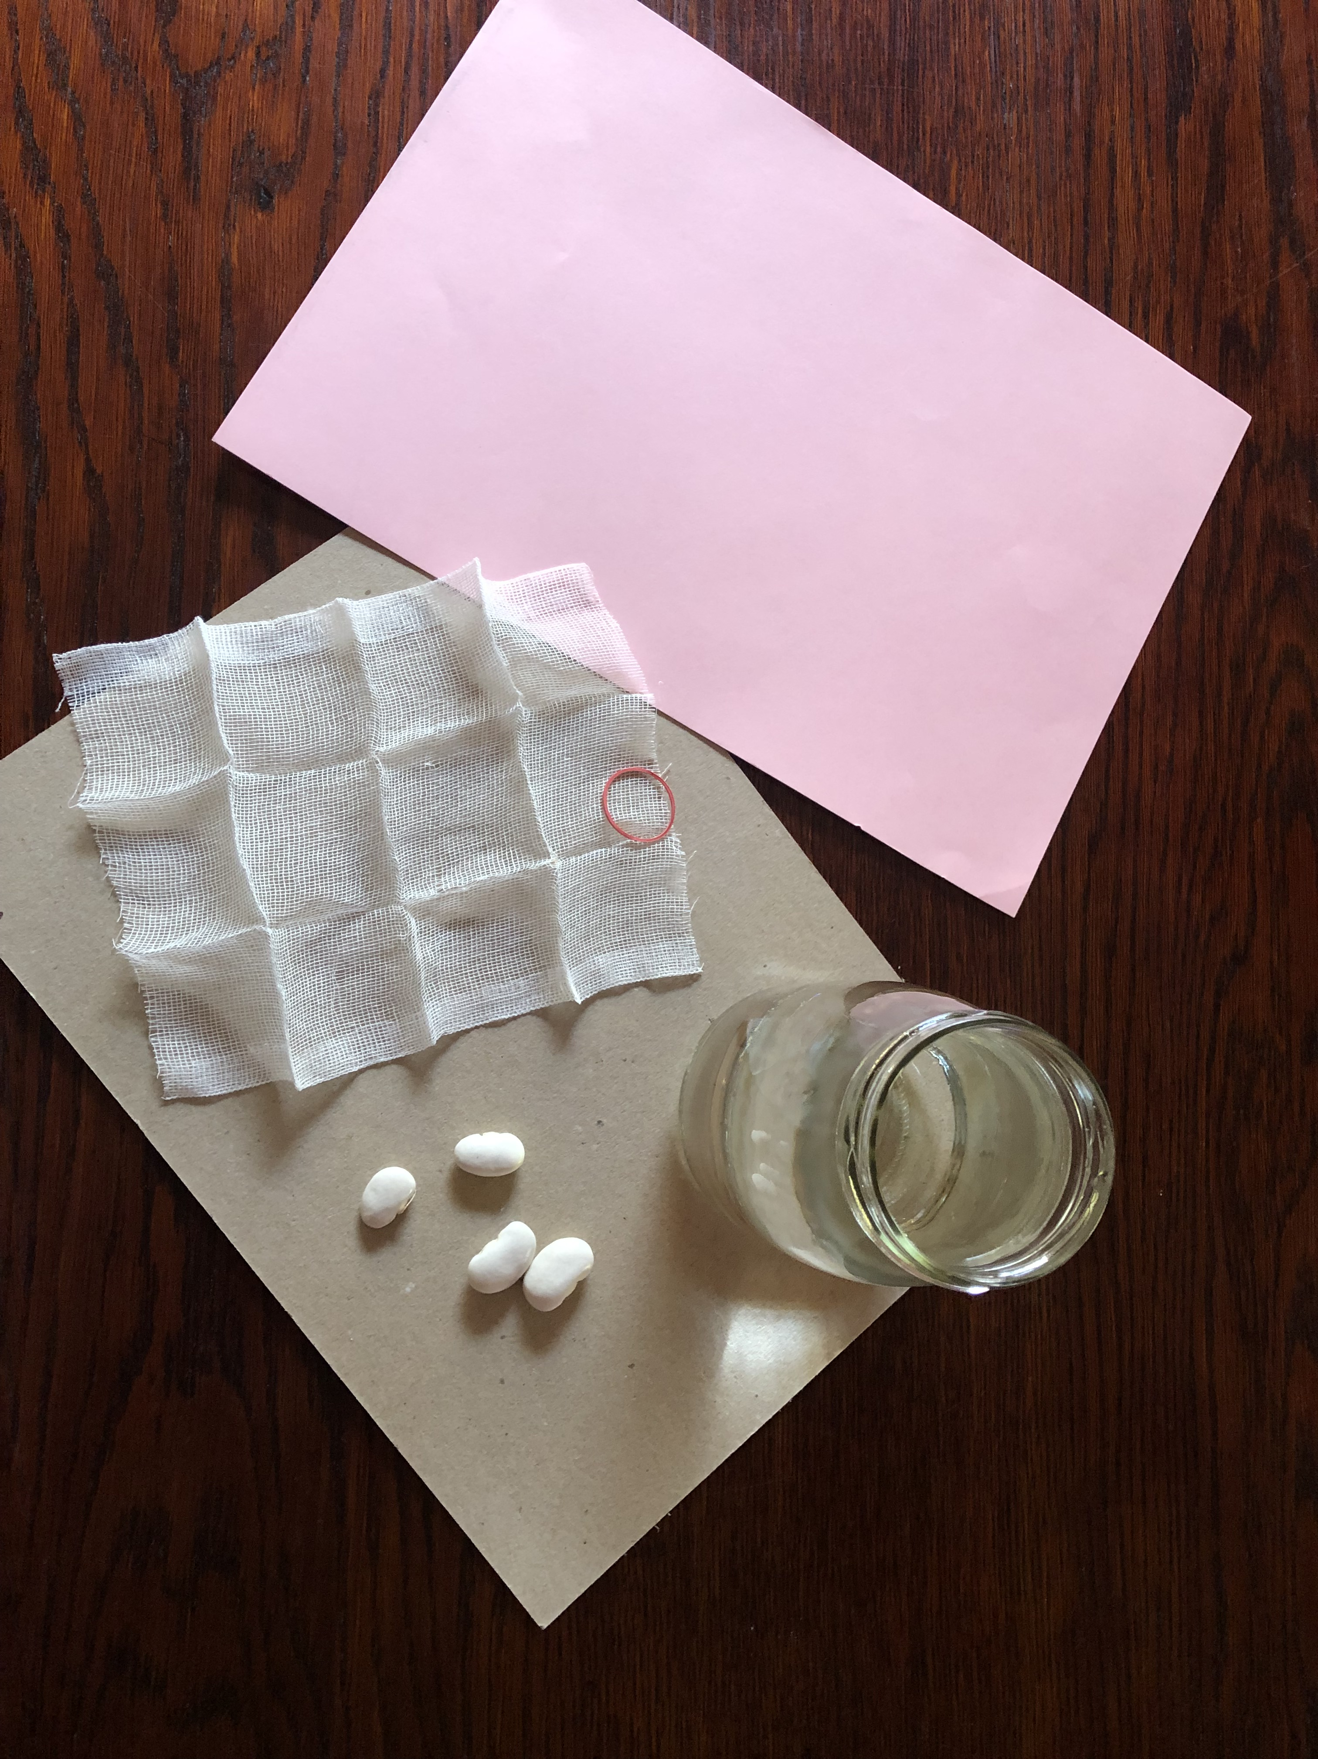
What you need
Two jars of water
Some loose material like bandage and two rubber bands
Some bean seeds
A large piece of dark, thick paper
Make sure you have two sets for the experiment !

Slide 5
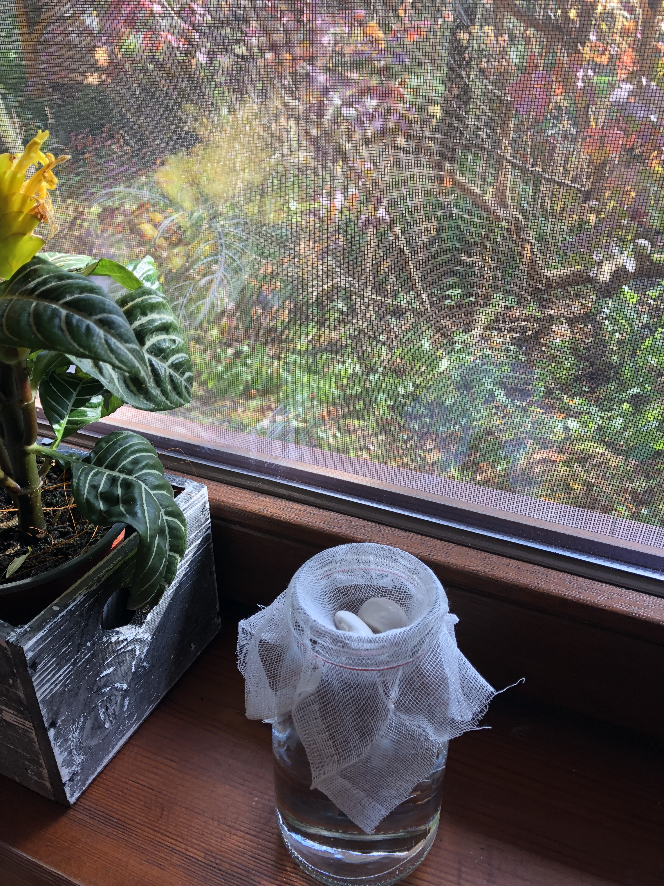
Stage 1
Pour some cold water to both jars
Cut out two pieces of material to cover the jars
Put the rubber band around to keep the material still
Put the bean seed on the material
Press the bean seed so that it is partly in water
Place the bean on the window sill

Slide 6
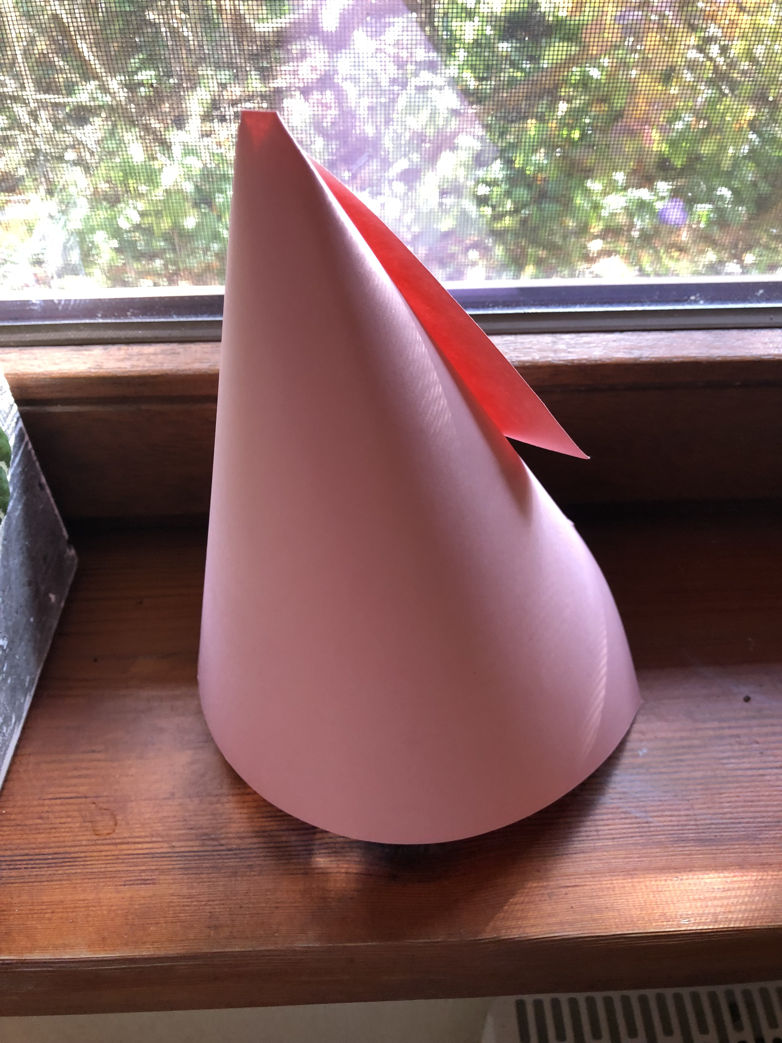
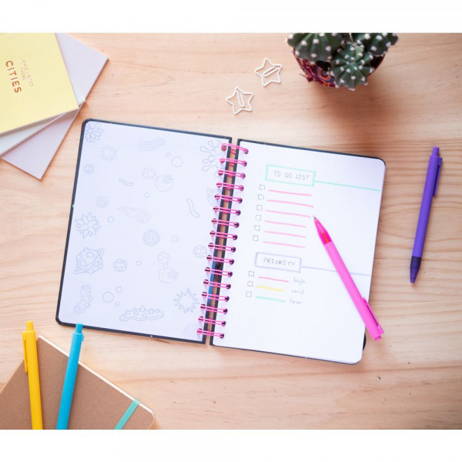
Stage 2
Put another jar next to he first one
Put the darkening hat on the jar
Observe both jars every day and take notes
Remember to write down wha it happening on which day

Slide 7
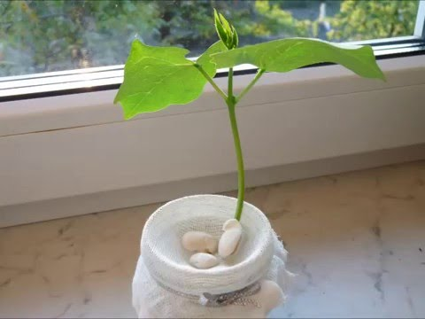
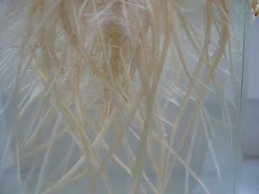
Findings
Try to answer these questions:
1. How long does it take for a seed to germinate
2. What are the stages?
3. What is ratio of the stem to the roots? Are they similar in capacity?
4. What happened to the bean in the dark? Why?
5. What is the conditio of the plant at the beginning,
what is it after a few more days growing only in water? Why?

Slide 8
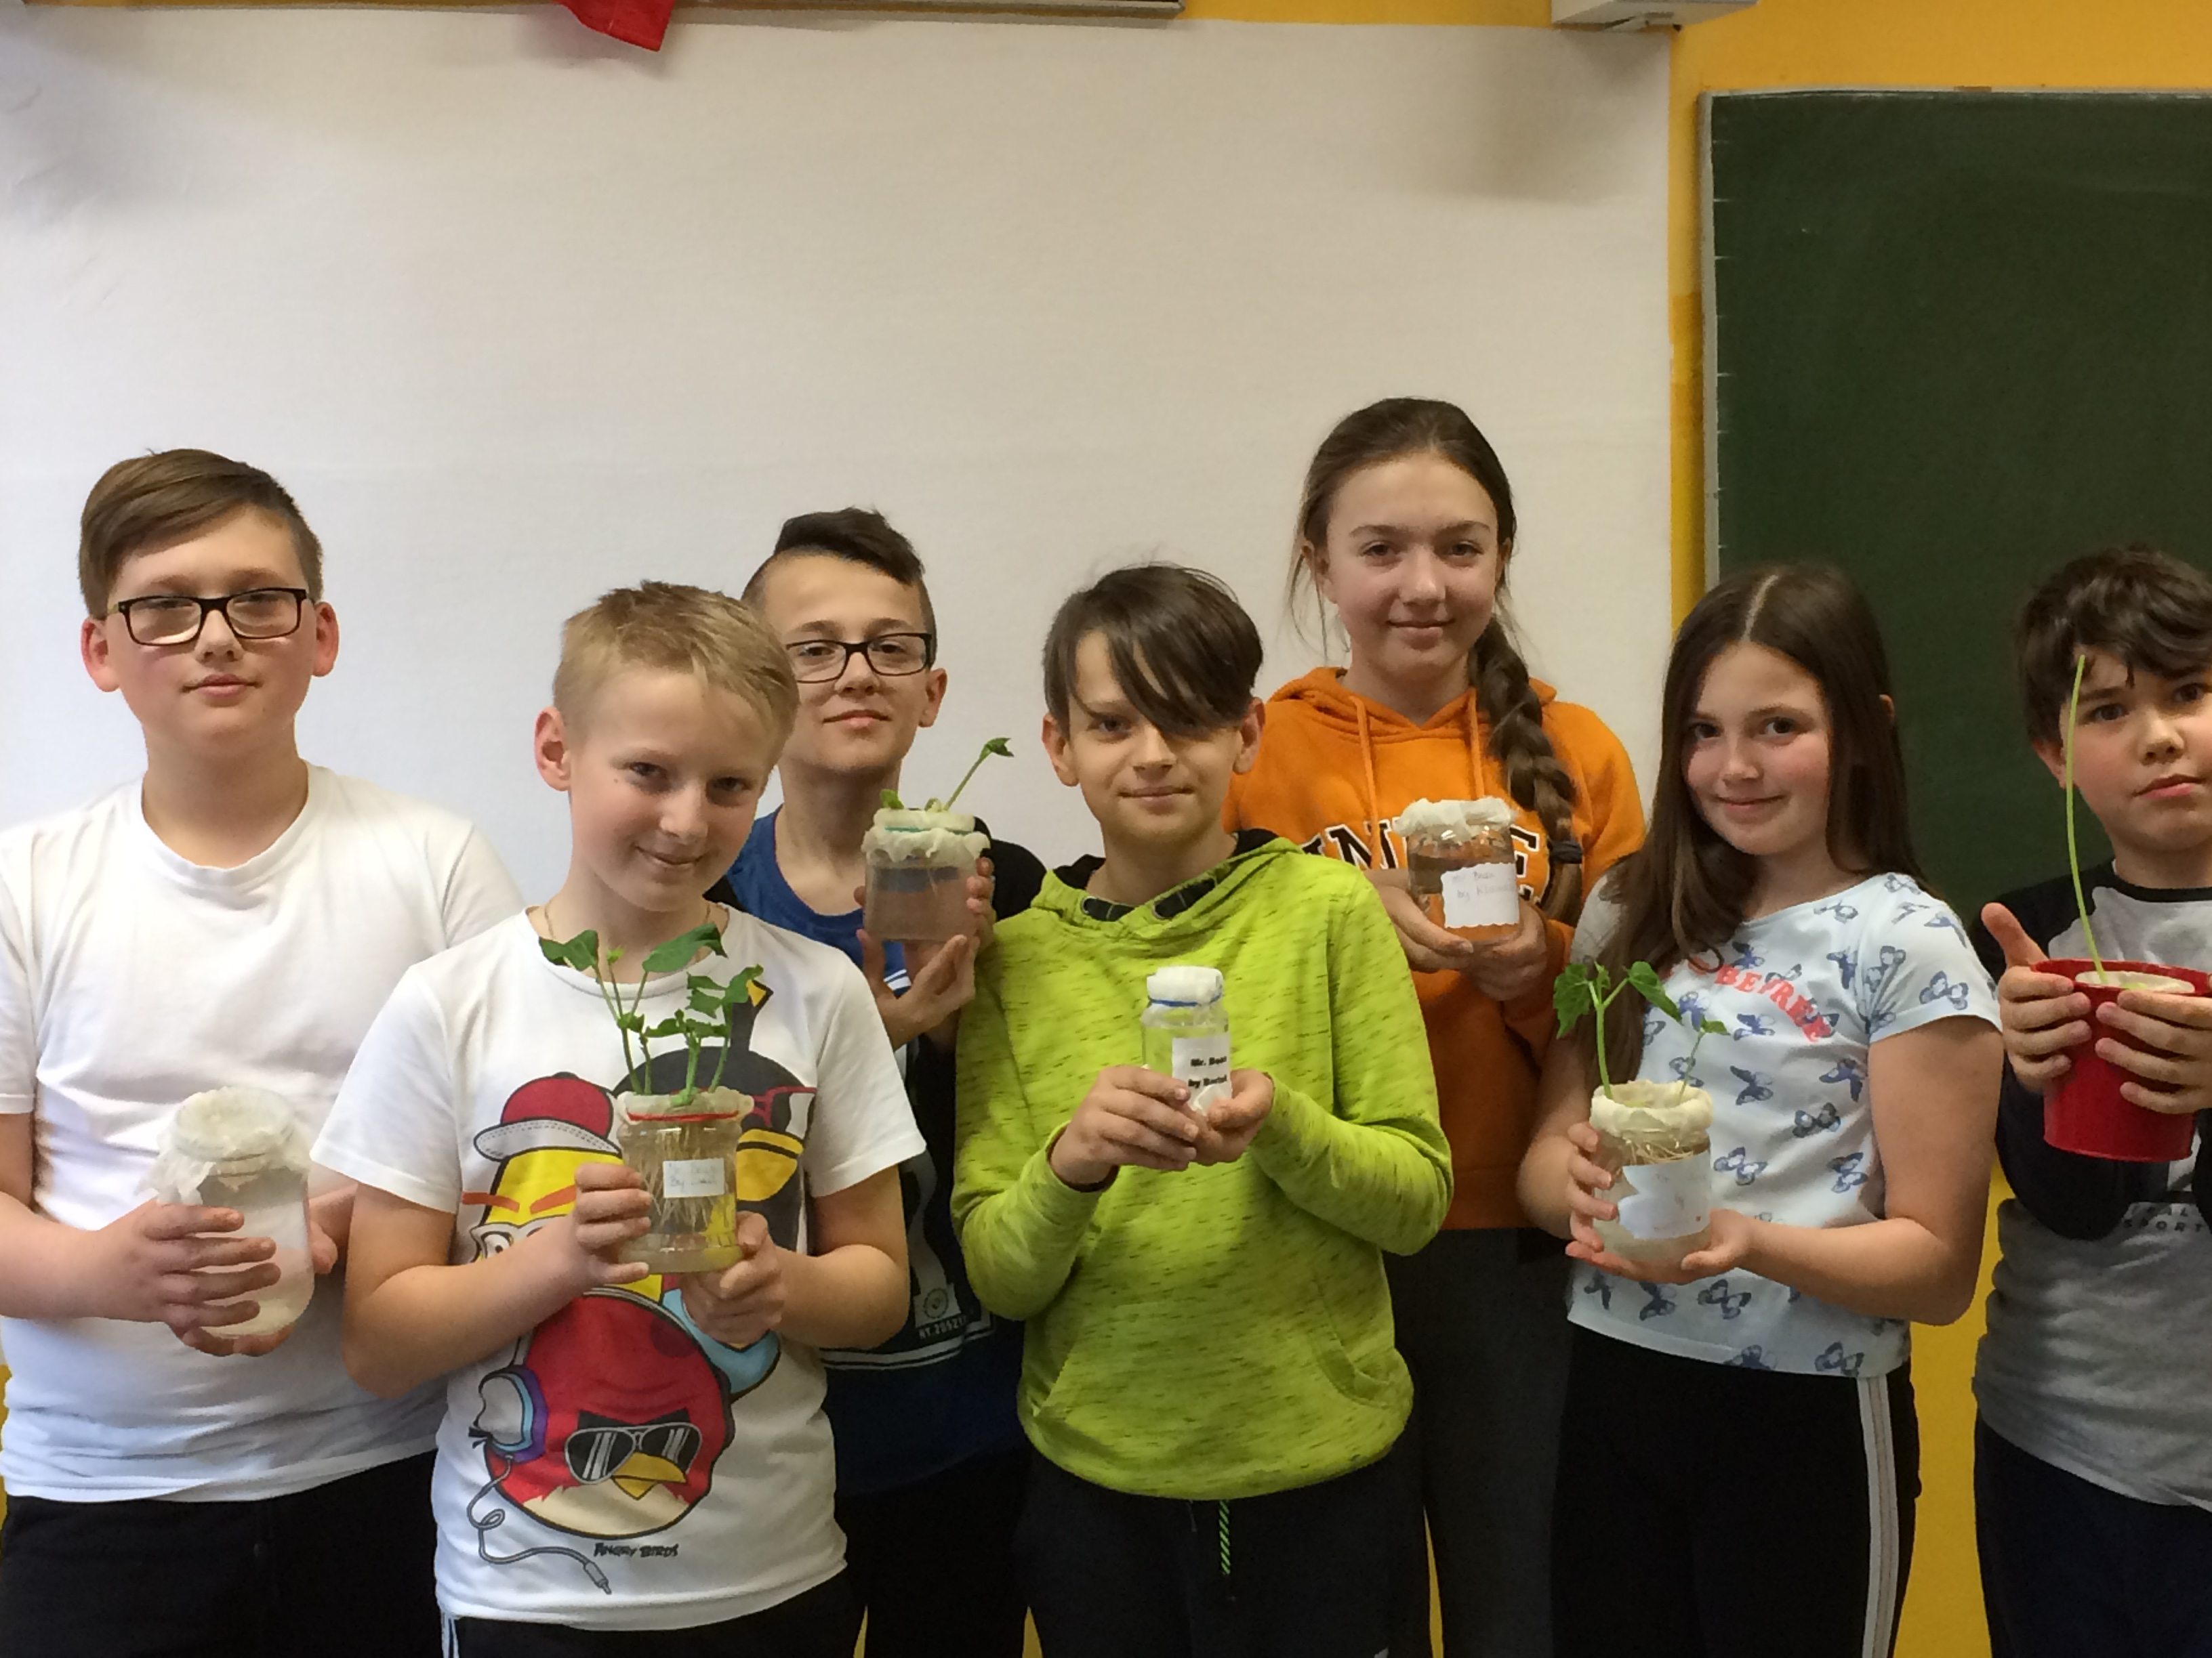
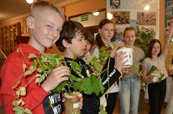
The End
Try to formulate the full description of the experiment and draw some conclusions to answer the question:
What is needed for seeds to germinate and grow?

